Slide 1
Project Proposal and Related Work
Department of Artificial Intelligence Convergence
-Monir

Slide 2
Project Title
오픈소스 LLM을 활용한 온프레미스 AI 기반 제품 추천 모델 개발
Development of an on-Premise AI Product Recommendation Model Using Open-Source LLM
Project Description
The e-commerce market is becoming increasingly competitive, requiring advanced recommendation systems.
Large marketplaces use sophisticated AI models, but independent online store operators lack such solutions.
This project aims to develop an AI-powered product recommendation system tailored for self-managed online stores.
By analyzing customer preferences, the system will suggest products that align with their interests.
Project Objective
Develop an AI-based search and recommendation system that analyzes user input sentences and recommends the TOP 5 most relevant products based on semantic similarity.
Utilize Natural Language Processing (NLP) and vector search technology to provide a highly refined search experience.
Deploy in an on-premise environment to ensure data privacy and full control over the recommendation process.

Slide 3
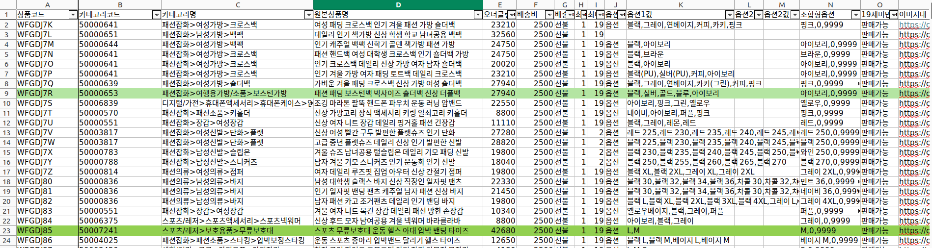
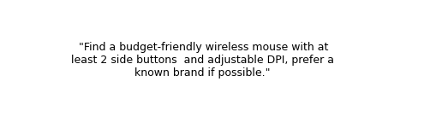





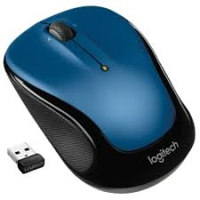
Input
The user inputs natural language queries (e.g., product preferences, budget, brand).
The system also references user interaction history and browsing behavior (previous chatbot sessions) if available.
Output
Generates personalized top 5 product recommendations based on the provided query and pre-learned background knowledge.
Each recommendation includes product title, brief description, price, ratings, and image.
Context-aware justifications for recommendations.
If a user declines initial recommendations, the system dynamically adjusts by asking clarifying questions (e.g., preferred color, brand).
Fig2. User Input
Fig1. Dataset Overview
Fig3. Recommendation Output

Slide 4
Project Requirements
Key Requirements
Conversation-Based Interaction: Chatbot must maintain a natural flow and remember user input.
Multilingual Support: Respond appropriately to English and Japanese customer inquiries (product data remains in Korean).
Data Scale: Support recommendations from a dataset of over 4 million product records (OwnerClan and Naver sources).
Visuals: Display at least two product images in recommendations.
Alternative Recommendations: If a customer declines initial recommendations, the chatbot will prompt for additional criteria (e.g., color, brand).

Slide 5
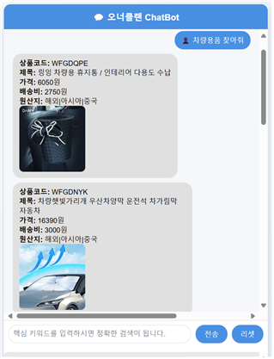
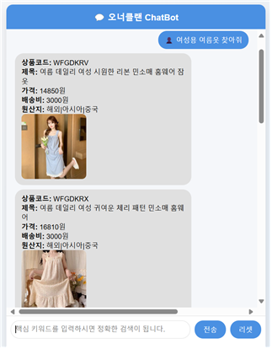
Proposed ChatBot User Interface
Fig4. ChatBot UI

Slide 6
Dataset Description
Fig5. Dataset

Slide 7
Dataset Description
Dataset Overview
OwnerClan Attribute-Refined Excel Test Data
  1st Batch: 7,000 items (provided on 25/03/11)
  2nd Batch: 4 million items (provided on 25/04/10)
Data Contents
Product Descriptions: Detailed textual descriptions of products.
Features: Product ID, Category, Product Name, Price, Discounted Price, Shipping Type, Stock Quantity, Main Image URL, Additional Image URLs, Brand, Country of Origin, Keywords, Timestamp, Detailed Description, and Shipping Weight.
Attribute Data: Classification codes, titles, country of origin, and other metadata.
Keyword-Based Metadata: Tags and keywords that facilitate search and categorization.
Data Processing
Preprocessing: Convert Excel data into structured embeddings via data cleaning, tokenization, and feature extraction.
Embedding: Optimize search by converting text into high-dimensional vector representations using the OpenAI text-embedding-ada-002 model.

Slide 8
Pre-Processing Plan and Evaluation Metrics
Data Cleaning: Remove duplicate and incomplete records.
Feature Engineering: Extract meaningful keywords for recommendations such as category encoding, keyword augmentation.
Vectorization: Convert textual data into embeddings using FAISS/ChromaDB (using OpenAI text-embedding-ada-002).
Retrieval-Based Evaluation Metrics (For RAG & Vector Search): Precision@K, Recall@K, Mean Reciprocal Rank (MRR), Normalized Discounted Cumulative Gain (NDCG)
Recommendation Effectiveness Metrics (For Chatbot & LLM): Mean Average Precision (MAP), BLEU Score (For LLM Response Quality), ROUGE Score.
User Experience & Engagement Metrics: Click-Through Rate (CTR), Conversion Rate.
Evaluation Metrics

Slide 9
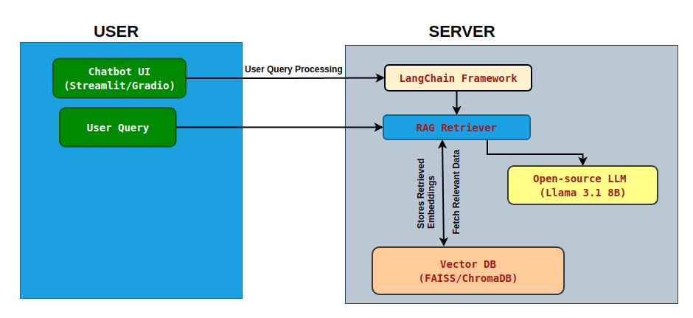
System Configuration (AI Model) Diagram
The system integrates multiple AI components as follows:
Data Processing & Storage
  Convert Excel product data into structured embeddings.
  Store embeddings in a vector database (FAISS or ChromaDB).
Retrieval-Augmented Generation (RAG) Model
  Retrieve relevant product information using vector search.
  Generate recommendations using an open-source LLM (e.g., Llama 3.1 8B).
LangChain Framework
  Manage interactions between the LLM and external data sources.
Chatbot Interface
  GUI-based interface (using Streamlit or Gradio) for customer interactions.
Fig 6: System Configuration Overview

Slide 10
List of Related Papers
Katlariwala, MuhammadZaid, and Aakash Gupta. "Product Recommendation System Using Large Language Model: Llama-2." In 2024 IEEE World AI IoT Congress (AIIoT), pp. 0491-0495. IEEE, 2024.
Chang, Ting-Jui, Lydia Hsiao-Mei Lin, and Richard Tzong-Han Tsai. "Conversational Product Recommendation using LLM." In 2024 IEEE 4th International Conference on Electronic Communications, Internet of Things and Big Data (ICEIB), pp. 340-343. IEEE, 2024.
Lyu, Hanjia, Song Jiang, Hanqing Zeng, Yinglong Xia, Qifan Wang, Si Zhang, Ren Chen, Christopher Leung, Jiajie Tang, and Jiebo Luo. "Llm-rec: Personalized recommendation via prompting large language models." arXiv preprint arXiv:2307.15780 (2023).
Roumeliotis, Konstantinos I., Nikolaos D. Tselikas, and Dimitrios K. Nasiopoulos. "Precision-Driven Product Recommendation Software: Unsupervised Models, Evaluated by GPT-4 LLM for Enhanced Recommender Systems." Software 3, no. 1 (2024): 62-80.
Zhao, Zihuai, Wenqi Fan, Jiatong Li, Yunqing Liu, Xiaowei Mei, Yiqi Wang, Zhen Wen et al. "Recommender systems in the era of large language models (llms)." IEEE Transactions on Knowledge and Data Engineering (2024).

Slide 11
Project Schedule (Gantt Chart)
Phase | 2025
 | March |  |  |  | April |  |  |  | May |  |  |  | June
 | 1 | 2 | 3 | 4 | 1 | 2 | 3 | 4 | 1 | 2 | 3 | 4 | 1 | 2
Project Understanding and Data Collection
Data Analysis and Pre-processing
AI Model Selection and Training
System Development
Chatbot UI Development
Testing and Deployment

Slide 12
Related Work Summary

Slide 13
List of related papers or systems – 1
This paper proposes a product recommendation system using the Llama-2 Large Language Model (LLM).
Traditional recommendation systems rely on collaborative filtering and content-based filtering, which have limitations such as the cold start problem and difficulty capturing complex user preferences.
The study explores the capabilities of LLMs in overcoming these challenges by leveraging natural language understanding and personalized user embeddings.
The system generates user embeddings based on past interactions and uses them to rank recommended products.
Evaluated using real-world e-commerce data, the Llama-2-based system outperformed traditional recommendation models in terms of click-through rate and purchase rate.
LLM-based personalization: Uses Llama-2 to generate context-aware and highly relevant recommendations.
Cold Start Solution: Addresses the cold start problem by leveraging text-based inputs from new users and products.
Dynamic User Interaction: Allows real-time refinement of recommendations based on user feedback.
Advanced Fine-Tuning Techniques: Utilizes Parameter-Efficient Fine-Tuning (PEFT) & LoRA to optimize the model for product recommendations.
Scalability & Performance: Demonstrates that LLMs can enhance recommendation accuracy and engagement metrics.
Katlariwala, MuhammadZaid, and Aakash Gupta. "Product Recommendation System Using Large Language Model: Llama-2." In 2024 IEEE World AI IoT Congress (AIIoT), pp. 0491-0495. IEEE, 2024.

Slide 14
List of related papers or systems – 1
Good Points (Strengths)
Effectively understands user preferences using natural language processing.
Generates recommendations for new users/products without relying on historical data.
Achieves higher click-through and purchase rates than traditional models.
Uses PEFT & LoRA fine-tuning, reducing computational costs.
Can be adapted for various recommendation tasks beyond e-commerce.
Points to be Improved (Limitations & Challenges)
LLMs require high processing power, making real-time recommendations challenging.
LLM-generated content may be biased or hallucinate incorrect recommendations.
Does not leverage image/video metadata, which could improve recommendations.
Model response time may be slower compared to traditional recommendation algorithms.
Need for further evaluation in large-scale commercial settings.
Questions to the Authors
How does the model handle real-time recommendation scenarios where low latency is critical?
What techniques can be used to reduce bias in LLM-generated product recommendations?
How does Llama-2 compare to other LLMs (e.g., GPT-4, Mistral) in terms of recommendation accuracy?
Can this approach be extended to multimodal recommendations, incorporating images and videos?
What are the cost and infrastructure requirements for deploying Llama-2-based recommendation systems at scale?
Katlariwala, MuhammadZaid, and Aakash Gupta. "Product Recommendation System Using Large Language Model: Llama-2." In 2024 IEEE World AI IoT Congress (AIIoT), pp. 0491-0495. IEEE, 2024.

Slide 15
List of related papers or systems – 2
This paper explores the use of Large Language Models (LLMs) for conversational product recommendation in e-commerce.
Unlike traditional recommendation systems, it emphasizes dialog-based interaction to understand user preferences dynamically.
Retrieval-Augmented Generation (RAG) is employed to enhance recommendations by pulling structured product information.
The model was trained on MOMO e-commerce data, focusing on cosmetics and health supplements.
Experimental results show that LLM-driven conversations outperform static recommendation models.
Conversational AI-based Recommendation: Uses LLMs to simulate sales assistant dialogues.
Cold Start Handling: Enables product recommendation without relying on past user behavior.
User Persona Simulation: Generates potential user profiles based on product features.
RAG Integration: Enhances product search accuracy by using retrieved product descriptions.
Scalability: Demonstrates adaptability across different product categories.
Chang, Ting-Jui, Lydia Hsiao-Mei Lin, and Richard Tzong-Han Tsai. "Conversational Product Recommendation using LLM." In 2024 IEEE 4th International Conference on Electronic Communications, Internet of Things and Big Data (ICEIB), pp. 340-343. IEEE, 2024.

Slide 16
List of related papers or systems – 2
Good Points (Strengths)
Enhanced user engagement through interactive chat-based recommendations.
Addresses the cold start problem by leveraging product descriptions instead of relying on past data.
Integration of Retrieval-Augmented Generation (RAG) for more precise responses.
Supports multi-turn conversations, refining recommendations dynamically.
Demonstrates effectiveness in real-world data from MOMO e-commerce.
Points to be Improved (Limitations & Challenges)
Limited evaluation on diverse product categories beyond cosmetics and supplements.
Computationally intensive, requiring significant resources for real-time chat-based recommendation.
Potential biases in persona generation, affecting recommendation fairness.
Lack of multilingual support, which limits global applicability.
No direct comparison with existing conversational AI recommendation models.
Questions to the Authors
How does this model compare to conventional chatbot-based recommendation systems?
What are the response time constraints for real-time use in e-commerce platforms?
How can bias in persona simulation be mitigated?
Can the model support multimodal recommendations (text + images)?
How would this approach perform in low-resource languages?
Chang, Ting-Jui, Lydia Hsiao-Mei Lin, and Richard Tzong-Han Tsai. "Conversational Product Recommendation using LLM." In 2024 IEEE 4th International Conference on Electronic Communications, Internet of Things and Big Data (ICEIB), pp. 340-343. IEEE, 2024.

Slide 17
List of related papers or systems – 3
This paper presents LLM-Rec, an approach that enhances personalized recommendations by leveraging prompting techniques for text-based recommendations.
It focuses on improving textual item descriptions using LLM-driven text augmentation.
The study introduces four prompting strategies to refine recommendation quality.
Empirical results demonstrate that even simple MLP models perform better with LLM-enhanced descriptions.
The approach is evaluated on Movielens-1M and Recipe datasets, showing significant performance improvement.
Introduction of Prompting Strategies: Uses basic, recommendation-driven, engagement-guided, and hybrid prompting.
Text Augmentation for Recommendation: Enhances item descriptions to align better with user preferences.
Versatile Domain Adaptability: Works across different content domains (movies, recipes, etc.).
Lightweight and Efficient: Achieves strong results without complex deep learning architectures.
Improved Recommendation Transparency: Augmented descriptions improve model explain ability.
Lyu, Hanjia, Song Jiang, Hanqing Zeng, Yinglong Xia, Qifan Wang, Si Zhang, Ren Chen, Christopher Leung, Jiajie Tang, and Jiebo Luo. "Llm-rec: Personalized recommendation via prompting large language models." arXiv preprint arXiv:2307.15780 (2023).

Slide 18
List of related papers or systems – 3
Good Points (Strengths)
Simple yet effective approach to improving recommendation performance.
Does not require retraining recommendation models, making it easy to integrate.
Works across multiple datasets (movies, recipes, and e-commerce data).
Enhances user experience by making recommendations more explainable.
Achieves high accuracy with minimal computational overhead.
Points to be Improved (Limitations & Challenges)
Limited to text-based data, ignoring other valuable product metadata (e.g., images, videos).
Dependence on prompt quality, which may vary across different datasets.
No real-time evaluation, making practical deployment challenging.
Possible biases in text augmentation, affecting recommendation fairness.
Limited discussion on security/privacy concerns when using LLMs.
Questions to the Authors
How does the model handle products with minimal textual descriptions?
Can the prompting techniques be extended to multimodal data?
How would this method compare to fine-tuned LLM-based recommenders?
What safeguards exist to prevent bias in text augmentation?
Could this approach be integrated into real-time recommendation systems?
Lyu, Hanjia, Song Jiang, Hanqing Zeng, Yinglong Xia, Qifan Wang, Si Zhang, Ren Chen, Christopher Leung, Jiajie Tang, and Jiebo Luo. "Llm-rec: Personalized recommendation via prompting large language models." arXiv preprint arXiv:2307.15780 (2023).

Slide 19
List of related papers or systems – 4
This paper proposes a precision-driven recommendation system that integrates unsupervised models (K-means, CBF, hierarchical clustering) with GPT-4 for evaluation.
Uses a Flask-based API to allow e-commerce owners to train and test recommendation models using CSV data.
GPT-4 is leveraged to assess and refine recommendation quality, reducing reliance on manual evaluation.
The system is designed to be efficient, scalable, and adaptable to various e-commerce needs.
Integration of unsupervised learning with LLM-based evaluation.
Use of GPT-4 as an automated evaluation tool for recommender systems.
User-friendly API for e-commerce integration.
Supports various recommendation techniques, including CBF and clustering.
Reduces reliance on human evaluation, making the process scalable.
Roumeliotis, Konstantinos I., Nikolaos D. Tselikas, and Dimitrios K. Nasiopoulos. "Precision-Driven Product Recommendation Software: Unsupervised Models, Evaluated by GPT-4 LLM
for Enhanced Recommender Systems." Software 3, no. 1 (2024): 62-80.

Slide 20
List of related papers or systems – 4
Good Points (Strengths)
Efficient model evaluation using GPT-4.
Supports multiple recommendation strategies.
Easy-to-use API for businesses.
Reduces manual evaluation efforts, saving time and resources.
Scalable for large-scale applications.
Points to be Improved (Limitations & Challenges)
High dependency on GPT-4, making costs unpredictable.
Limited discussion on explainability of recommendations.
No real-time deployment evaluation.
Possible bias in GPT-4 evaluations.
Lack of benchmarks against existing state-of-the-art recommendation models.
Questions to the Authors
How does GPT-4 evaluation compare to human assessments?
What are the cost implications of using GPT-4 at scale?
How can this system ensure fairness and avoid biases in recommendations?
Can this framework be extended to incorporate real-time feedback loops?
How well does the system perform against deep-learning-based recommenders?
Roumeliotis, Konstantinos I., Nikolaos D. Tselikas, and Dimitrios K. Nasiopoulos. "Precision-Driven Product Recommendation Software: Unsupervised Models, Evaluated by GPT-4 LLM
for Enhanced Recommender Systems." Software 3, no. 1 (2024): 62-80.

Slide 21
List of related papers or systems – 5
This survey paper explores the impact of Large Language Models (LLMs) on modern recommender systems (RecSys).
Traditional Deep Neural Networks (DNNs) have advanced RecSys but struggle with textual side information, generalization, and reasoning.
LLMs like ChatGPT and GPT-4 significantly enhance recommendation capabilities due to their language understanding and reasoning skills.
The paper systematically reviews three main approaches to integrating LLMs with RecSys:
  Pre-training LLMs for representation learning.
  Fine-tuning LLMs for personalized recommendations.
  Using prompting techniques to guide LLMs in recommendation tasks.
Discusses future trends, including multimodal recommendations, ethical concerns, and real-world deployment challenges.
Comprehensive review of LLM-powered recommender systems.
Evaluation of different LLM-based learning paradigms (pre-training, fine-tuning, prompting).
Insightful discussion on explainability and generalization in RecSys.
Exploration of advanced reasoning techniques to improve recommendation quality.
Future outlook on multimodal, ethical, and scalable recommendation models.
Zhao, Zihuai, Wenqi Fan, Jiatong Li, Yunqing Liu, Xiaowei Mei, Yiqi Wang, Zhen Wen et al. "Recommender systems in the era of large language models (llms)." IEEE Transactions on Knowledge and Data Engineering (2024).

Slide 22
List of related papers or systems – 5
Good Points (Strengths)
Thorough and structured review of recent advances in LLM-driven recommendation.
Comparison of different paradigms, offering insights for researchers and practitioners.
Addresses challenges of traditional RecSys, highlighting LLM advantages.
Explores real-world applications across diverse domains.
Suggests promising future directions, guiding further research in the field.
Points to be Improved (Limitations & Challenges)
Lacks empirical evaluations, focusing primarily on theoretical discussions.
No performance benchmarks comparing LLM-based RecSys with traditional methods.
Limited discussion on practical deployment constraints, such as latency and computational costs.
Does not address security and privacy risks of using LLMs in RecSys.
No concrete implementation guidelines for applying LLM techniques in real-world settings.
Questions to the Authors
What are the real-world constraints in deploying LLM-powered recommendation models?
How do LLM-based recommenders compare in online A/B testing scenarios?
What strategies can mitigate bias and fairness issues in LLM-generated recommendations?
How can multimodal inputs (e.g., images, videos) enhance LLM-driven recommendations?
What measures can improve the explainability of LLM-powered RecSys for end-users?
Zhao, Zihuai, Wenqi Fan, Jiatong Li, Yunqing Liu, Xiaowei Mei, Yiqi Wang, Zhen Wen et al. "Recommender systems in the era of large language models (llms)." IEEE Transactions on Knowledge and Data Engineering (2024).

Slide 23
Thank You for Listening

